Slide 1


Refactoring to a S.O.L.I.D. Foundation
Steve Bohlen
Principal Software Engineer
& Technical Evangelist
CSE
sbohlen@gmail.com http://blog.unhandled-exceptions.com @sbohlen

Slide 2

























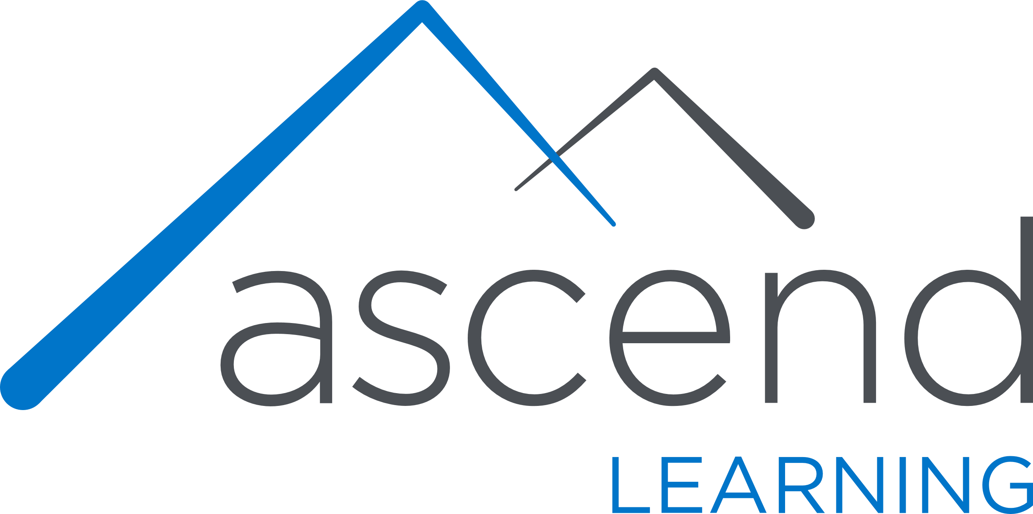











TITANIUM SPONSORS
Platinum Sponsors
Gold Sponsors

Slide 3
Who am I?
…and why should you care?
Steve Bohlen
I Read Books + Write Software
vs. “Read Software + Write Books” ☺
Blog, Screencast, Speak, Share, Learn

Slide 4


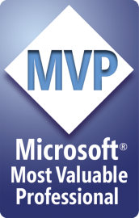
Steve Bohlen
Over 25 years as a software developer
LISP, Delphi, C/C++, VB, VB.NET, Java, Ruby, C#, JavaScript, node.js
Principal Software Engineer, Microsoft
Co-Founder, NYC Alt.Net User Group
http://nyalt.net
Co-Organizer, NYC DDD User Group
http://dddnyc.org
Contributor: various OSS projects
NHibernate http://www.nhforge.org
NDbUnit http://www.googlecode.com/ndbunit
Spring.NET http://www.springframework.net
Common.Logging http://github.com/net-commons/common-logging
blog: http://blog.unhandled-exceptions.com
e-mail: sbohlen@gmail.com
twitter: @sbohlen
Membership: ASP Insiders, C# Insiders, Telerik Insiders, INETA Board of Directors
Alumni

Slide 5

I am a
employee…
…but these thoughts are my own!

Slide 6


Slide 7


Slide 8
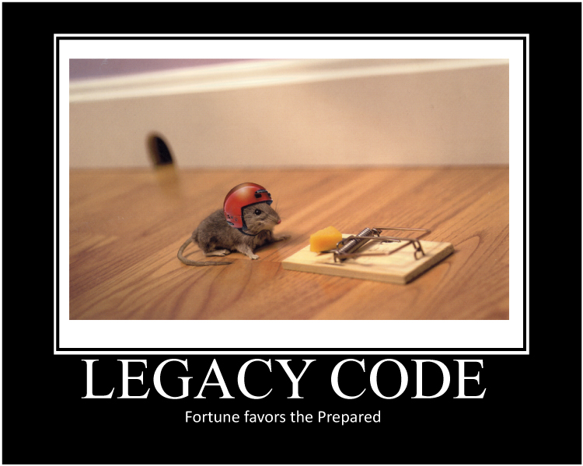

Slide 9
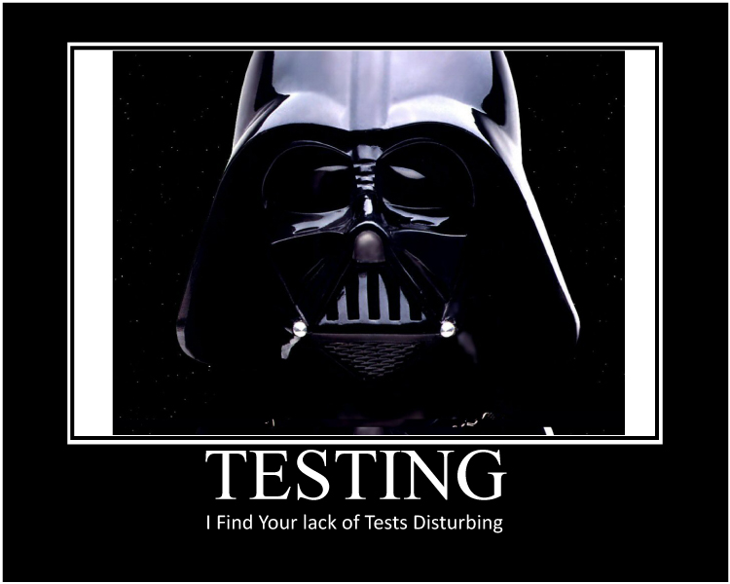

Slide 10
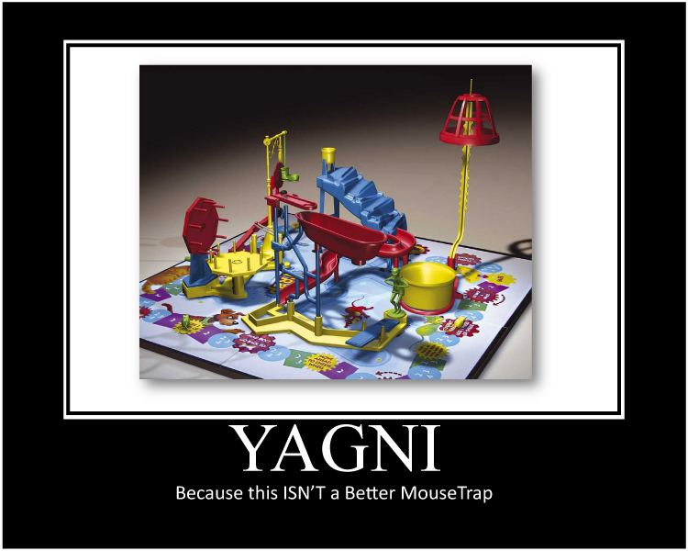

Slide 11


Slide 12
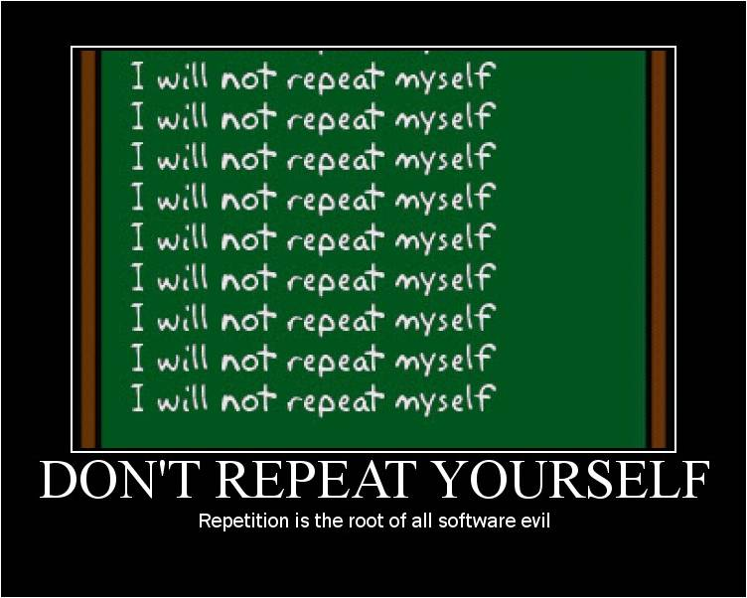

Slide 13
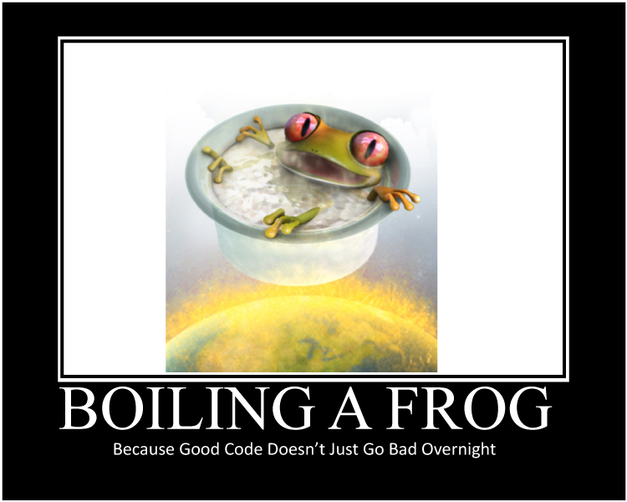

Slide 14
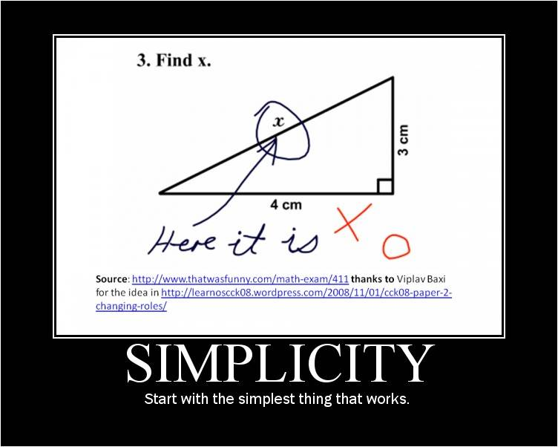

Slide 15


Slide 16
Refactoring Tools
Developer Express CodeRush
http://devexpress.com/coderush
JetBrains Resharper
http://www.jetbrains.com/resharper/
Visual Studio
Notepad!

Slide 17
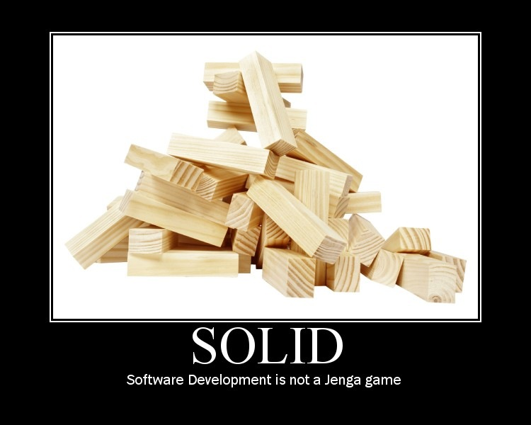

Slide 18
Introduction to S.O.L.I.D.
S
O
L
I
D
RP
ingle Responsibility Principle
CP
pen-Close Principle
SP
iskov Substitution Principle
SP
nterface Segregation Principle
IP
ependency Inversion Principle

Slide 19
Introduction to S.O.L.I.D.
S
O
L
I
D
ingle Responsibility Principle
pen-Close Principle
iskov Substitution Principle
nterface Segregation Principle
ependency Inversion Principle

Slide 20
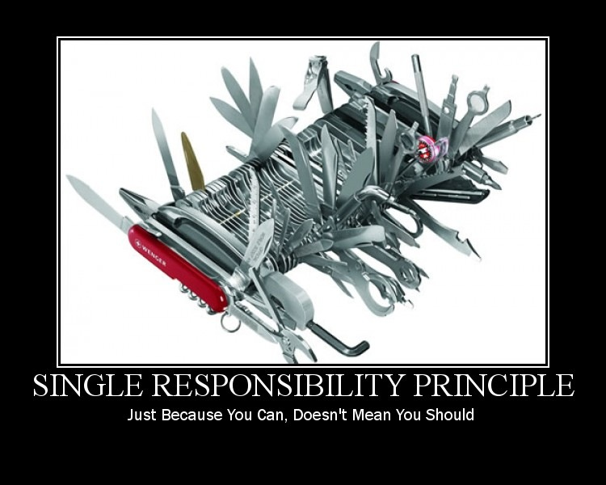

Slide 21
Single Responsibility Principle
There should never be more than one reason for a class to change.

Slide 22
Refactoring to a S.O.L.I.D. Foundation
SRP Demo

Slide 23
Introduction to S.O.L.I.D.
S
O
L
I
D
ingle Responsibility Principle
pen-Close Principle
iskov Substitution Principle
nterface Segregation Principle
ependency Inversion Principle

Slide 24
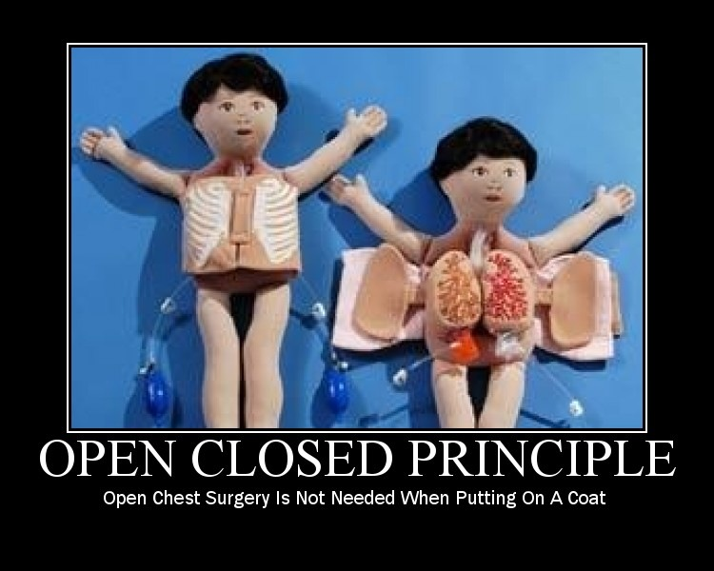

Slide 25
Open-Closed Principle
Software Entities (Classes, Modules, Functions, etc.)should be Open for Extension, but Closed for Modification.

Slide 26
Refactoring to a S.O.L.I.D. Foundation
OCP Demo

Slide 27
Introduction to S.O.L.I.D.
S
O
L
I
D
ingle Responsibility Principle
pen-Close Principle
iskov Substitution Principle
nterface Segregation Principle
ependency Inversion Principle

Slide 28
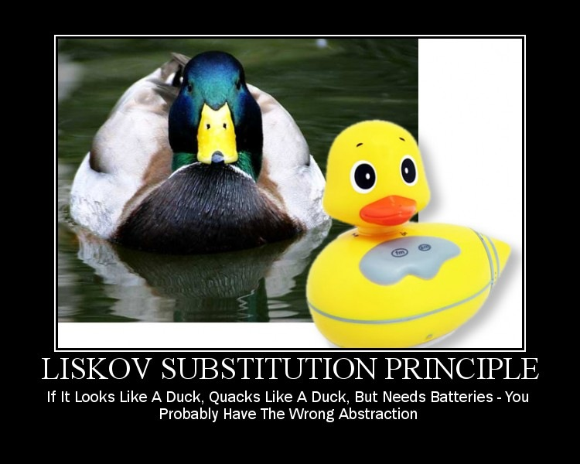

Slide 29
Liskov Substitution Principle
If for each object o₁ of type S
there is an object o₂ of type T such that
for all programs P defined in terms of T,
the behavior of P is unchanged when o₁ is substituted for o_{2,} then S is a subtype of T.
WTF ?!?

Slide 30
Liskov Substitution Principle
Functions that use pointers or references to base classes must be able to use objects of derived classes without knowing it.

Slide 31
Refactoring to a S.O.L.I.D. Foundation
LSP Demo

Slide 32
Introduction to S.O.L.I.D.
S
O
L
I
D
ingle Responsibility Principle
pen-Close Principle
iskov Substitution Principle
nterface Segregation Principle
ependency Inversion Principle

Slide 33
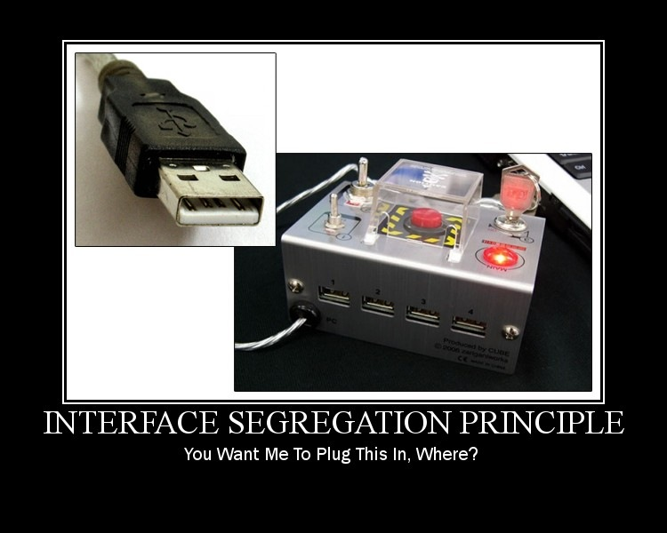

Slide 34
Interface Segregation Principle
Clients should not be forced to depend upon interfaces that they do not use.

Slide 35
Refactoring to a S.O.L.I.D. Foundation
ISP Demo

Slide 36
Introduction to S.O.L.I.D.
S
O
L
I
D
ingle Responsibility Principle
pen-Close Principle
iskov Substitution Principle
nterface Segregation Principle
ependency Inversion Principle

Slide 37
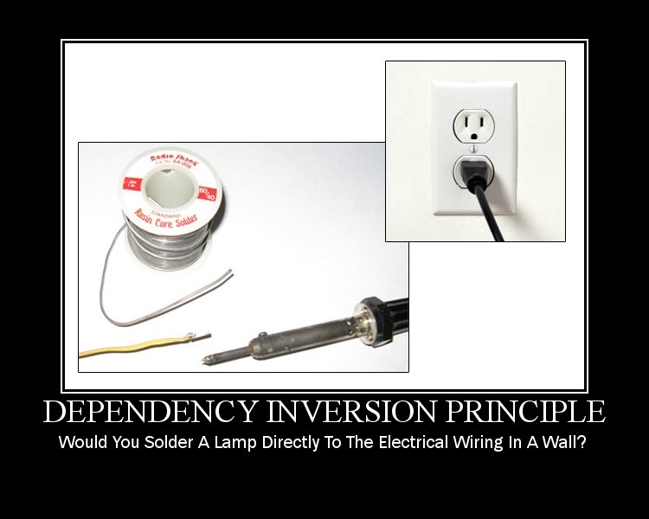

Slide 38
Dependency Inversion Principle
High Level Modules should not depend
upon Low Level Modules. Both should
depend upon abstractions.
Abstractions should not depend upon details. Details should depend upon abstractions.

Slide 39
Refactoring to a S.O.L.I.D. Foundation
DIP Demo

Slide 40
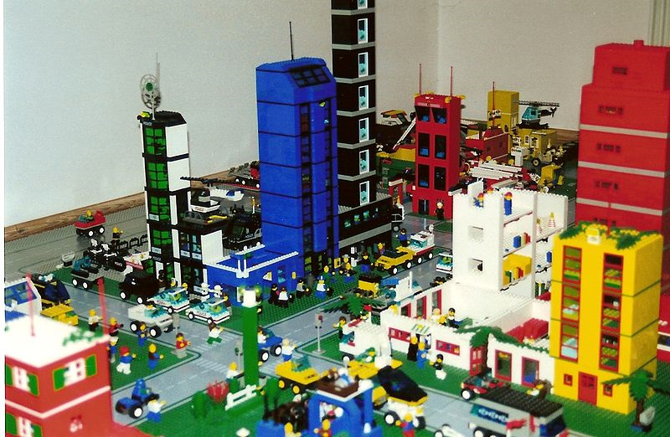
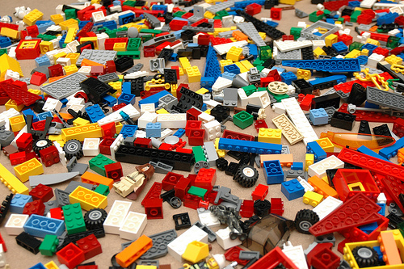
Thinking About Re-Assembly
Presto!

Slide 41
Dependency Injection Frameworks
StructureMap
AutoFac
Castle Windsor
NInject
Funq
Unity
More…

Slide 42
Refactoring to a S.O.L.I.D. Foundation
Closing Thoughts

Slide 43
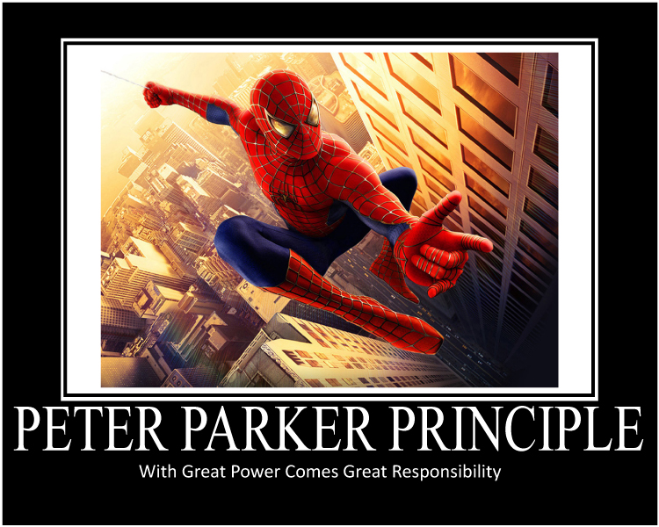

Slide 44
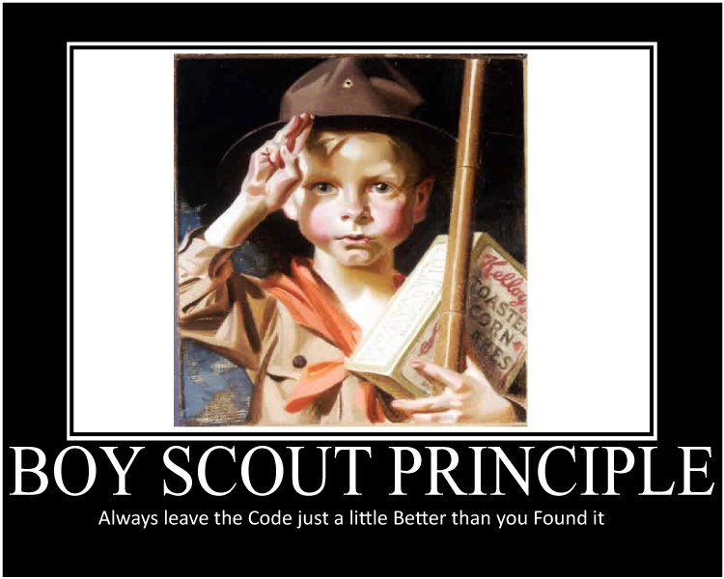

Slide 45
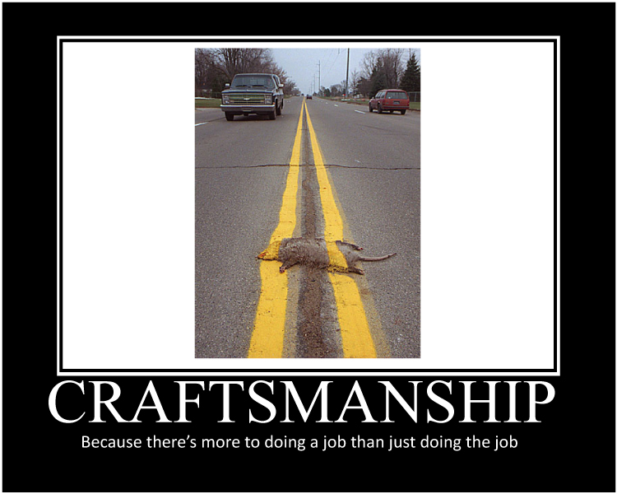

Slide 46
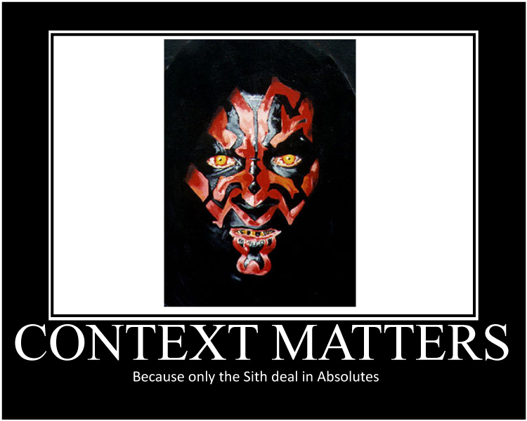

Slide 47
https://www.pluralsight.com/courses/principles-oo-design
SOLID Principles of Object Oriented Design
Steve Bohlen
Principal Software Engineer
& Technical Evangelist
CSE
sbohlen@gmail.com http://blog.unhandled-exceptions.com @sbohlen

